Slide 1
Global economic outlook
Emerging from a deep recession
Joseph Wu, CFA
Portfolio Advisory Group
July 2020 | RBC Dominion Securities Inc.

Slide 2
Topics and themes
Taking stock of the economic damage inflicted by the pandemic
Have governments done enough to “plug” the massive economic hole?
Looking for signs of a nascent economic recovery
Manufacturing coming back online
The current COVID-19 situation: Cases, fatalities, vaccines and treatments
What are some of the economic risks that could undercut the recovery
Some thoughts around Canadian dollar and de-globalization

Slide 3
Global economy: Solid rebound expected after worst recession since 1945
Have governments done enough to “plug” the massive economic hole? Coordinated “throw as many kitchen sinks as need” fiscal stimulus approach
Keep a floor underneath economy, ensure there are businesses to reopen and consumers to spend. In doing so, minimize the tail risks to the outlook and support the eventual recovery.
 | 2020 GDP Forecast | 2021 GDP Forecast | Fiscal policy | Monetary policy
U.S. | -7.1% | +5.7% | $2.9 trillion stimulus (15% of GDP) | Rates cut to 0-0.25% Unlimited asset purchases
Canada | -8.8% | +3.8% | $324 billion stimulus (14% of GDP) | Rate cut to 0.25% Asset purchases expanded to $5 billion a week
China | -0.1% | +10.7% | $860 billion stimulus (6.1% of GDP) | Rates cut o 2.95% Bank reserve requirement ratio cut by 1.50-2.00%
Japan | -7.9% | +1.8% | ¥234 trillion stimulus (14.5% of GDP) Package includes measures announced prior to pandemic | Short-term rate at -0.10% with 10-year yield capped at 0% Unlimited asset purchases
Germany | -6.2% | +5.0% | €320 billion stimulus (13.7% of GDP) | ECB deposit rate at -0.50% Asset purchases expanded by €120 billion
Source: RBC Wealth Management, Bloomberg, RBC GAM; data through 6/30/20

Slide 4
Global economy: Liquidity, stimulus, reopening underpinning nascent recovery
Q2 will likely mark worst of the downturn but prospects of a second wave remains a key risk
Consumer confidence tumbled from February-April but are starting to perk up after tumble in March-April
Source: RBC Wealth Management, Bloomberg, Goldman Sachs; data through 6/30/20

Slide 5
Manufacturing: Emerging from a deep pandemic-induced recession
Manufacturing activity not quite back to “growth mode” but have bounced considerably off the lows in March-April
U.S. and China manufacturing sector have returned to expansion … Canada not far behind
PMI of 50 demarcates expansion from contraction
PMI of 50 demarcates expansion from contraction
Source: RBC Wealth Management, Bloomberg; data through 6/30/20

Slide 6
Industrial production: Emerging from a deep pandemic-induced recession
U.S. vehicle sales have rebounded smartly off the lows and pent-up demand should continue to drive recovery…
Chinese industrial production (June) has recovered strongly, while industrial production in Canada and the U.S. should show considerable improvement once data for June are published
…as have Chinese auto sales
Source: RBC Wealth Management, Bloomberg; data through 6/30/20

Slide 7
COVID-19: Resurgence risk vs. global race to find vaccines and treatments
An extraordinary effort undertaken to fight COVID-19, with over 150 vaccine and 250 treatment candidates in various stages of development. Over the next few months, we will continue to get news on progress and setbacks in the vaccine/treatment race
Stable fatalities allowing for gradual reopening but new cases remain worrisome with uncertain implications of renewed (localized) lockdowns
Source: RBC Wealth Management, Bloomberg, Milken Institute; data through 7/7/20.

Slide 8
Economic risks: Mindful of lagged secondary effects after “easy part” of recovery
In the labour market, what portion of the currently temporary laid off workers will end up in permanent unemployment?
Government loan guarantees and other aid packages have been effective at dampening bankruptcies so far in this recession, but could the default cycle worsen if the economic recovery turns out to be uneven and/or subpar
Source: RBC Wealth Management, Bloomberg; data through 6/30/20

Slide 9
Canadian dollar: “Undervalued” but likely range-bound amid domestic uncertainty
 | 2020 |  |  | 2021
 | Q3F | Q4F |  | Q1F | Q2F | Q3F | Q4F
CAD/USD | 0.72 | 0.71 |  | 0.72 | 0.73 | 0.74 | 0.74
Source: RBC Wealth Management, Bloomberg; data through 6/30/20

Slide 10
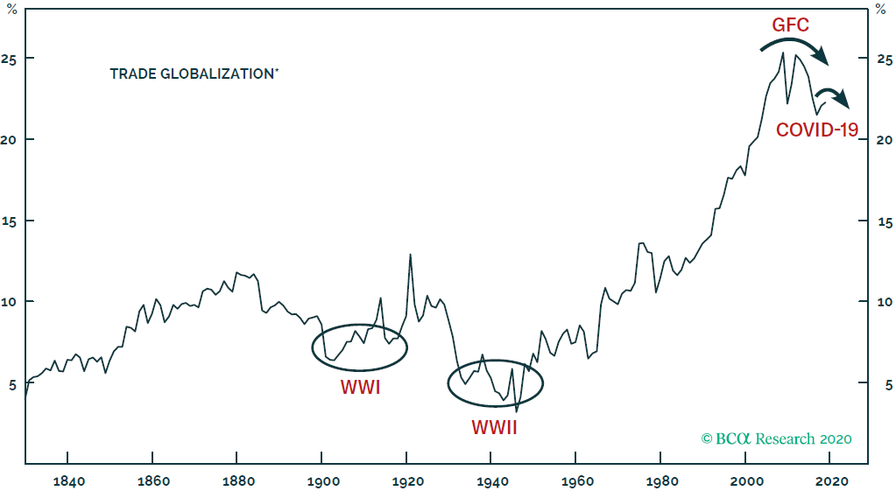
(De)-Globalization: Selective re-shoring could gain momentum in coming years
Globalization occurs in waves … import-to-GDP ratio appears have peaked amid rising nationalism and increased desire to have greater control over supply chains, particularly around essential and strategic goods
Source: BCA Research
Note: Measured by imports as a percent of GDP weighted by population. BCA calculation from 1994. Number of countries varies based on data availability.

Slide 11
Thank you!
Questions?

Slide 12
RBC Group Advantage
The same old way is not working anymore. Time for disruption.
Insurance companies
RBC Group Advantage
No proactive outreach to Members
Outdated tools to support decision making
Opaque pricing models for Sponsors
Lack of understanding of financial wellness for Members
Regular touchpoints with employees
MyAdvisor connecting employees to holistic financial advice
Simple and transparent pricing
Full service Bank meeting all aspects of a employees’ financial needs
Putting the employee at the centre of all we do
12

Slide 13
RBC Group Advantage
Why RBC Group Advantage?
As Canada’s largest Bank, we are different.
Insurance companies are limited in what they can offer to your employees for holistic financial wellness
Financial wellness is our business.
Supporting individuals is what we do . Let us use our expertise to ensure a healthy retirement for your employees.
We like simple. It works.
A seamless experience for you and your employees is our goal.
Time to save money. No hidden fees.
We tell it like it is. You know your costs upfront and there are no surprises. It’s better that way.
13

Slide 14
RBC Group Advantage
How we approach financial wellness
Holistic financial advice to ensure your employees are prepared
Making access simple through MyAdvisor, phone, online and 1200 branch locations across Canada
Bringing education into the workplace delivered by RBC experts
Tools, calculators and research available online, all the time
When your employees win, we all win.
14

Slide 15
RBC Group Advantage
What’s in it for you?
1
2
3
4
5
A dedicated Relationship Manager to ensure your plan is healthy and meeting your needs.
A plan backed by award-winning investments with a proven track record.
Financial support for your employees backed by the strength of RBC.
Simple and transparent pricing on all our products.
A different way of approaching retirement planning – with your employee's best interests at heart.
15

Slide 16
Thank you.
Jason Smith, MBA,CFP, CIM, Wealth Advisor, RBC DS
jason.smith@rbc.com
OR
Jamie Pepper, Group Consultant, Windsor Kent
jamie.pepper@rbc.com
The material in this presentation is intended as a general source of information only, and should not be construed as offering specific tax, legal, financial or investment advice. Every effort has been made to ensure that the material is correct at time of publication, but we cannot guarantee its accuracy or completeness. Interest rates, market conditions, tax rulings and other investment factors are subject to rapid change. Individuals should consult with their personal tax advisor, accountant or legal professional before taking any action based upon the information contained in this presentation.
RBC Funds® are offered by RBC Global Asset Management Inc. and distributed through authorized dealers. Guaranteed investment certificates (GICs) are products of Royal Bank of Canada or its affiliates. Financial planning services and investment advice are provided by Royal Mutual Funds Inc. or RBC Dominion Securities Inc.^{Δ} Royal Mutual Funds Inc. is licensed as a financial services firm in Quebec. RBC Global Asset Management Inc., Royal Mutual Funds Inc., RBC Dominion Securities Inc., RBC Direct Investing Inc.^{Δ} and Royal Bank of Canada are separate corporate entities which are affiliated.
Δ Member–Canadian Investor Protection Fund.
® / ™ Trademark(s) of Royal Bank of Canada. RBC and Royal Bank are registered trademarks of Royal Bank of Canada. ‡ All other trademarks are the property of their respective owner(s).

